Slide 1
Lecture 13 Shortest Paths
Department of Computer Science
Hofstra University
Acknowledgement: Lecture slides based on UofW Course on Data Structures

Slide 2
BFS
Dijkstra’s Algorithm
Topological Sort
Bellman-Ford Algorithm
Johnson’s Algorithm

Slide 3
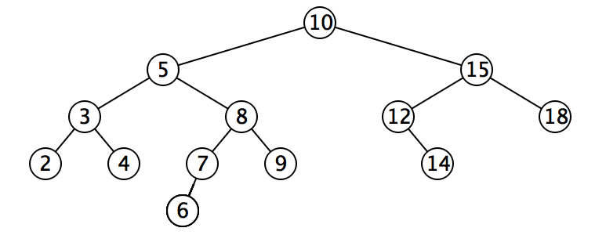
Review: Graph traversal w/ DFS
Depth First Search: go as far as you can down one path till you hit a dead end (no neighbors, or no unvisited neighbors). Once you hit a dead end, backtrack and try other edges that you have not tried yet
Analogy of wandering a maze – if you get stuck at a dead end, trace your steps backwards to the previous fork in the road, and try a different path
one valid DFS traversal: 10, 5, 3, 2, 4, 8, 7,6, 9, 15, 12, 14, 18
Notes:
(since you physically have to go and try it out to know it’s a dead end)

Slide 4
Review: Graph traversal w/ BFS
Breadth First Search - traverse level by level, and visit 1-hop neighbors before 2-hop neighbors before 3-hop neighbors…
Analogy: sound wave spreading from a starting point, going outwards in all directions; mold on a piece of food spreading outwards so that it eventually covers the whole surface
one valid BFS traversal: 10, 5, 15, 3, 8, 12, 18, 2, 4, 7, 9, 14, 6

Slide 5
BFS for (Unweighted) Shortest Path Problem
BFS can find shortest paths in an unweighted graph
BFS visits nodes in order of their distance from the source node, ensuring the first path found to any node is the shortest possible path in terms of the number of edges
Time complexity: O(V+E)
Advantages:
Optimal for unweighted graphs
Simple implementation
Limitations:
Only works for unweighted graphs
(Unweighted) Shortest Path Problem
Given source node s (start) and a target node t, how long is the shortest path from s to t? What edges makeup that path?
Notes:
Not suitable for graphs with negative edges

Slide 6
BFS for Shortest Paths in an Unweighted Graph
...
Map<Node, Edge> PN = ...
Map<Node, Double> SD = ...
PN.put(start, null);
SD.put(start, 0.0);
while (!perimeter.isEmpty()) {
Node from = perimeter.remove();
for (Edge edge : graph.edgesFrom(from)) {
Node to = edge.to();
if (!visited.contains(to)) {
PN.put(to, edge);
SD.put(to, SD.get(from) + 1);
perimeter.add(to);
visited.add(to);
}
}
}
return PN;
}
Keep track of how far each node is from the start with two maps
SD: Shortest Distance from source node
PN: Previous Node stores backpointers: each node remembers what node was used to arrive at it
PERIMETER
A
B
C
D
E
SD
2
E
VISITED
0
start
A
1
C
PN
1
B
2
D
Notes:
The start required no edge to arrive at, and is on level 0
Remember how we got to this point, and what layer this node is part of

Slide 7
Shortest Path Tree
SD
2
E
VISITED
0
The table of SD/PN encodes the Shortest Path Tree (SPT), which encodes the shortest path and distance from the start node to every other node
Shortest path to any node can be obtained from SPT
Length of shortest path from A to D?
Lookup in SD map: 2
What’s the shortest path from A to D?
Build the path backwards from PN: start at D, follow backpointer to B, follow backpointer to A – the shortest path is ABD
start
A
1
C
PN
1
B
2
D
Node | SD | PN
A | 0 | /
B | 1 | A
C | 1 | A
D | 2 | B or C
E | 2 | C
Depending on the order of visiting A’s successors with BFS: either B before C, or C before B, D’s PN may be either B or C
Notes:
A general concept: in this implementation, made up of distances and backpointers

Slide 8
BFS Time Complexity
Using Adjacency List: O(V + E)
Each node is processed exactly once: O(V)
Each edge is examined exactly once: O(E)
Total complexity: O(V + E)
Efficient for sparse graphs (where E is much less than V²)
Using Adjacency Matrix: O(V²)
For each node, we must check all possible edges to other vertices
This results in O(V²) operations regardless of the actual number of edges

Slide 9
BFS
Dijkstra’s Algorithm
Topological Sort
Bellman-Ford Algorithm
Johnson’s Algorithm

Slide 10
Dijkstra’s Algorithm
Named after its inventor, Edsger W. Dijkstra (1930-2002)
1972 Turing Award
Solves the Shortest Path Problem on a weighted graph
start
A
14.0
C
target
12.0
1.5
B
D
9000.2
Notes:
Suppose we want to find shortest path from A to C, using weight of each edge as “distance”
The idea: reminiscent of BFS, but adapted to handle weights
Nodes not in the set will have a “best distance so far”

Slide 11

Edge Relaxation
Relax edge e = u→v with weight w(u,v). (We also write edge uv to denote u→v)
SD[u] is length of shortest known path from s to u.
SD[v] is length of shortest known path from s to v.
PN[v] is the previous node on shortest known path from s to v.
If e = u→v gives shorter path to v through u, update SD[v] and PN[v].
SD[v] = min(SD[v], SD[u] + w(u,v)); PN[v]=u
After relaxing edge uv, the shortest path from s to v is updated to go through node u, with cost of 4.4
private void relax(DirectedEdge e)
{
Int u = e.from(), v = e.to();
if (SD[v] > SD[u] + w(u,v))
{
SD[v] = SD[u] + w(u,v);
PN[v] = u;
}
}
PN[v]=u
3.1
u
1.3
s
v
7.2
OLD PN(v)=x, SD[v] = 7.2 > SD[u] + w(u,v) = 3.1+1.3 = 4.4
NEW SD[v] ← SD[u] + w(u,v) = 4.4, PN[v] = u
x
Previous shortest path from s to v goes through node x, with cost of 7.2
Notes:
Dijkstra’s Algorithm is greedy and optimal: any node that has been visited should have its shortest distance to the source.

Slide 12
Generic Shortest-paths Algorithm
Generic algorithm (to compute SPT from s)
For each node v: SD[v] = ∞.
For each node v: PN[v] = null.
SD[s] = 0.
Repeat until done:
- Relax any edge.
Proposition. Generic algorithm computes SPT (if it exists) from s.
Proof.
Throughout algorithm, SD[v] is the length of a simple path from s to v (and PN[v] is its previous node on the path).
Each successful relaxation decreases SD[v] for some v.
The entry SD[v] can decrease at most a finite number of times.
Efficient implementations. How to choose which edge to relax?
Ex 1. Dijkstra’s algorithm. (no negative weights)
Ex 2. Topological sort. (DAG with no directed cycles)
Ex 3. Bellman–Ford algorithm. (negative weights, can detect negative cycles)
Notes:
Ex 2. Topological sort algorithm. (no directed cycles).

Slide 13
Dijkstra's Algorithm
Initialization:
Set the distance to the source node as 0 and to all other nodes as infinity.
Mark all nodes as unvisited and store them in a priority queue.
Main Loop:
Visit the unvisited node u with the shortest known distance (minimum SD) from the queue.
For each unvisited neighbor node v of node u, calculate its tentative distance through the current node. If this distance is smaller than the previously recorded distance, update it with edge relaxation for edge uv.
Mark the current node as visited once all its neighbors are processed.
Termination:
The algorithm continues until all reachable nodes are visited.
Notes:
Greedy and optimal algorithm: any node that has been visited should have its shortest distance to the source.
It works for both undirected and directed graphs. The only difference is how to get neighbors of node v, as each undirected edge is treated as two directed edges in both directions.
Notes:
which follows the edge arrow direction for directed graphs

Slide 14
Dijkstra’s Algorithm: Idea
PERIMETER
2
4??
UNKNOWN
0
2
2
3
∞
start
A
B
F
H
1
4
5
10
2
∞
1
9
1
3
G
4
2
C
KNOWN
D
11
1
E
7
12??
Initialization:
Start node has distance 0; all other nodes have distance ∞
At each step:
Pick the closest unknown node v (with smallest SD)
Add it to the “cloud” of known nodes (set of nodes whose shortest distance has been computed)
Update “best-so-far” distances for nodes with edges from v

Slide 15
Dijkstra’s Pseudocode (High-Level)
0
KNOWN
start
A
2
2
PERIMETER
B
5
Suppose we already visited B, SD[D] = 7
Now considering edge (C, D):
oldDist = 7
newDist = 3 + 1
Relaxation updates SD[D], PN[D]
3
3
7??
Similar to “visited” in BFS, “known” is set of nodes that have been visited and we know shortest paths to them
C
u
1
v
D
dijkstraShortestPath(G graph, V start)
Set known; Map PN, SD;
Init all paths to infinite.
initialize SD with all nodes mapped to ∞, except start to 0
while (there are unknown nodes):
let u be the closest unknown node
known.add(u);
Greedy algo: visit closest node first
for each edge (u,v) from u with weight w:
oldDist = SD.get(v) // previous best path to v
newDist = SD.get(u) + w // what if we went through u?
Consider all nodes reachable from the newly-added node u: would getting there through u be a shorter path than their current path length?
if (newDist < oldDist):
SD.put(v, newDist)
PN.put(v, u)
Notes:
Dijkstra’s algorithm is all about updating “best-so-far” in SD if we find shorter path!

Slide 16
Dijkstra’s Algorithm: Key Properties
Once a node is visited (marked known), its shortest path is known. Can reconstruct path by following back-pointers (in PN map)
dijkstraShortestPath(G graph, V start)
Set known; Map PN, SD;
initialize SD with all nodes mapped to ∞, except start to 0
while (there are unknown nodes):
let u be the closest unknown node
known.add(u)
for each edge (u,v) to unknown v with weight w:
oldDist = SD.get(v) // previous best path to v
newDist = SD.get(u) + w // what if we went through u?
if (newDist < oldDist):
SD.put(v, newDist)
PN.put(v, u)
While a node is not yet visited/known, another shorter path might be found. We call this update relaxing the distance because it only ever shortens the current best path
If we only need path to a specific node, can stop early once that node is visited, and return a partial shortest path tree
Notes:
Once a node is marked known, its shortest path is known
Can reconstruct path by following backpointers
While a node is not known, another shorter path might be found
The order in which nodes are added to the known set is unimportant
If we only need path to a specific node, can stop early once that node is known
Because its shortest path cannot change
Return a partial shortest path tree
It is not possible to find a shorter path that uses a farther node we’ll consider later

Slide 17
Dijkstra’s Algorithm: Runtime
dijkstraShortestPath(G graph, V start)
Set known; Map PN, SD;
initialize SD with all nodes mapped to ∞, except start to 0
while (there are unknown nodes):
let u be the closest unknown node
known.add(u)
for each edge (u,v) to unknown v with weight w:
oldDist = SD.get(v) // previous best path to v
newDist = SD.get(u) + w // what if we went through u?
if (newDist < oldDist):
SD.put(v, newDist)
PN.put(v, u)
update distance in list of unknown nodes
O(V)
O(V)
O(log V) using binary min-heap implementation of a priority queue
O(E)
O(log V)
Initialization: O(V)
Extracting nodes: O(V log V)
Edge relaxations: O(E log V)
Total runtime: O((V+E) log V)
Notes:
We can use an optimized structure that will tell us the “minimum” distance node, and let us “update distance” as we go… Use a HeapMinPriorityQueue! (like the one from P3)

Slide 18
Greedy Algorithms
A greedy algorithm makes the locally optimal choice at each step
Dijkstra’s is “greedy” because once a node is marked as visited, it is never revisited
This is why Dijkstra’s does not work with negative edge weights
In the lecture and exams, when there are multiple possible orders of visiting the next node (with equal SD value), select the next node in alphabetical or numerical order
The intermediate steps will depend on the order, but final result will be the same
Other examples of greedy algorithms are:
Kruskal and Prim’s minimum spanning tree algorithms
Notes:
“When there are multiple possible orders of visiting the next node, select the next node in alphabetical or numerical order.”
Dijkstra’s is “greedy” because once a node is marked as visited, it is never revisited
This is why Dijkstra’s does not work with negative edge weights
Huffman compression

Slide 19
Resolving Ambiguities
As There are typically multiple possible orders of the same graph. In the lecture and exams, we often use the following rule to resolve any ambiguities:
“When there are multiple possible orders of visiting the next node, select the next node in alphabetical or numerical order.”

Slide 20
Example I
0
2
∞
∞
∞
start
B
2
3
A
F
H
1
4
5
10
2
∞
1
9
∞
3
G
∞
2
C
11
∞
D
1
E
Node | SD | PN
A | 0 | /
B | ∞
C | ∞
D | ∞
E | ∞
F | ∞
G | ∞
H | ∞
7
Visit Order
Start from the source node A

Slide 21
Example I
0
2
2??
∞
∞
?? Means that SDs have not yet been finalized, as a shortcut may be found in the future.
start
B
2
3
A
F
H
1
4
5
10
2
∞
1
9
1??
3
G
4??
2
C
11
∞
D
1
E
Node | SD | PN
A | 0 | /
B | 2 | A
C | 1 | A
D | 4 | A
E | ∞
F | ∞
G | ∞
H | ∞
7
Visit Order
A
Visit C next, since C has the smallest SD of 1 among all unknown (unvisited) nodes

Slide 22
Example I
0
2
2??
∞
∞
start
B
2
3
A
F
H
1
4
5
10
2
∞
1
9
1
3
G
4??
2
C
11
12??
D
1
E
Node | SD | PN
A | 0 | /
B | 2 | A
C | 1 | A
D | 4 | A
E | 12 | C
F | ∞
G | ∞
H | ∞
7
Visit Order
A, C
Visit B next, since B has the smallest SD of 2 among all unvisited nodes
Notes:
Note how E’s distance is 12 (path length) instead of 11 (edge weight)

Slide 23
Example I
0
2
2
4??
∞
start
B
2
3
A
F
H
1
4
5
10
2
∞
1
9
1
3
G
4??
2
C
11
12??
D
1
E
Node | SD | PN
A | 0 | /
B | 2 | A
C | 1 | A
D | 4 | A
E | 12 | C
F | 4 | B
G | ∞
H | ∞
7
Visit Order
A, C, B
We can choose to visit either D or F next, since they have equal smallest SD of 4 among all unvisited nodes. Let’s visit D in alphabetical order
Notes:
Note how
Again, we don’t set F’s pathlen to 2 (the edge weight); we set it to 4 (length of A->B->F)
We don’t update C with distance 7 (A->B->C); its optimal path is already known
We don’t update E with distance 12 (A->B->E); the path length is the same

Slide 24
Example I
0
2
2
4??
∞
start
B
2
3
A
F
H
1
4
5
10
2
∞
1
9
1
3
G
4
2
C
11
12??
D
1
E
Node | SD | PN
A | 0 | /
B | 2 | A
C | 1 | A
D | 4 | A
E | 12 | C
F | 4 | B
G | ∞
H | ∞
7
Visit Order
A, C, B, D
Visit F next, since F has the smallest SD of 4 among all unvisited nodes
Notes:
Nothing was updated; we already had an optimal path to C

Slide 25
Example I
0
2
2
4
7??
start
B
2
3
A
F
H
1
4
5
10
2
∞
1
9
1
3
G
4
2
C
11
12??
D
1
E
Node | SD | PN
A | 0 | /
B | 2 | A
C | 1 | A
D | 4 | A
E | 12 | C
F | 4 | B
G | ∞
H | 7 | F
7
Visit Order
A, C, B, D, F
Visit H next, since H has the smallest SD of 7 among all unvisited nodes

Slide 26
Example I
0
2
2
4
7
start
B
2
3
A
F
H
1
4
5
10
2
8??
1
9
1
3
G
4
2
C
11
12??
D
1
E
7
Node | SD | PN
A | 0 | /
B | 2 | A
C | 1 | A
D | 4 | A
E | 12 | C
F | 4 | B
G | 8 | H
H | 7 | F
Visit Order
A, C, B, D, F, H
Visit G next, since G has the smallest SD of 8 among all unvisited nodes
Notes:
OLD SD[F] = $∞$ > SD[D] + w(D,F) = 7+2 = 9
NEW SD[F] ← SD[D] + w(D,F) = 9, PN[F] = D

Slide 27
Example I
0
2
2
4
7
start
B
2
3
A
F
H
1
4
5
10
2
8
1
9
1
3
G
4
2
C
11
11??
D
1
E
Node | SD | PN
A | 0 | /
B | 2 | A
C | 1 | A
D | 4 | A
E | 12 11 | C G
F | 4 | B
G | 8 | H
H | 7 | F
7
Visit Order
A, C, B, D, F, H, G
We found a shortcut to E going through G, so we update SD and PN for E. Visit E next, since it is the last unvisited node
Notes:
Note how we found a better path to E at last (A->B->F->H->G->E), with cost 11; formerly path A->C->E had cost 12

Slide 28
Example I Final
0
2
2
4
7
start
B
2
3
A
F
H
1
4
5
10
2
8
1
9
1
3
G
4
2
C
11
11
D
1
E
Node | SD | PN
A | 0 | /
B | 2 | A
C | 1 | A
D | 4 | A
E | 12 11 | C G
F | 4 | B
G | 7 8 | 8 H
H | 7 | F
7
Visit Order
A, C, B, D, F, H, G, E
All nodes have now been visited and are known
Notes:
The table now contains the SD (shortest distance) to each node N from the source node A, and its PN (previous node) in the shortest path. The table of SD/PN encodes the Shortest Path Tree (SPT)

Slide 29
Example I: Interpreting the Results
0
2
2
4
7
How to get the shortest path from A to E?
Follow PN backpointers to get path ABFHGE
start
B
2
3
A
F
H
1
4
5
10
2
8
1
9
1
3
G
4
2
C
11
11
D
1
E
Node | SD | PN
A | 0 | /
B | 2 | A
C | 1 | A
D | 4 | A
E | 11 | G
F | 4 | B
G | 8 | H
H | 7 | F
7
Visit Order
A, C, B, D, F, H, G, E
Notes:
Walk through the chain of “previous” (E->G->H->F->B->A)

Slide 30
Example I Exam Question and Answer
Given this directed graph, run Dijkstra’s Algo to find shortest paths starting from source node A. Give the node visit order, and fill in this table of SN (Shortest Distance) and PN (Previous Node), crossing out old SD and PN as you find a shortcut path with smaller SD
Visit Order
A, C, B, D, F, H, G, E
Node | SD | PN
A | 0 | /
B | 2 | A
C | 1 | A
D | 4 | A
E | 12 11 | C G
F | 4 | B
G | 7 8 | 8 H
H | 7 | F
2
2
3
start
A
B
F
H
1
4
5
10
2
1
9
3
G
2
C
11
D
1
E
7
Notes:
At exam time, you will be given a graph with a start node (A), and required to fill in this table, crossing out old items as you find a shortcut path

Slide 31
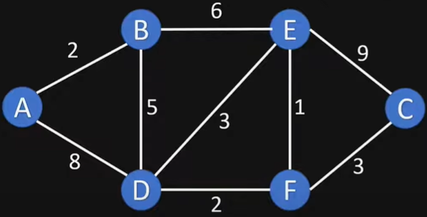
Example II
Dijkstras Shortest Path Algorithm Explained | With Example | Graph Theory
https://www.youtube.com/watch?v=bZkzH5x0SKU

Slide 32
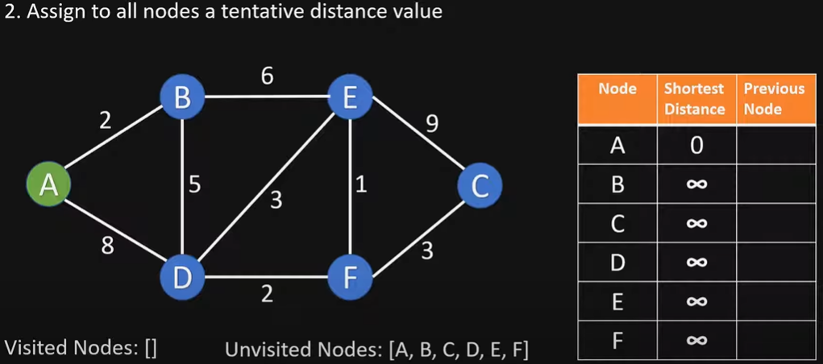
Initialize

Slide 33
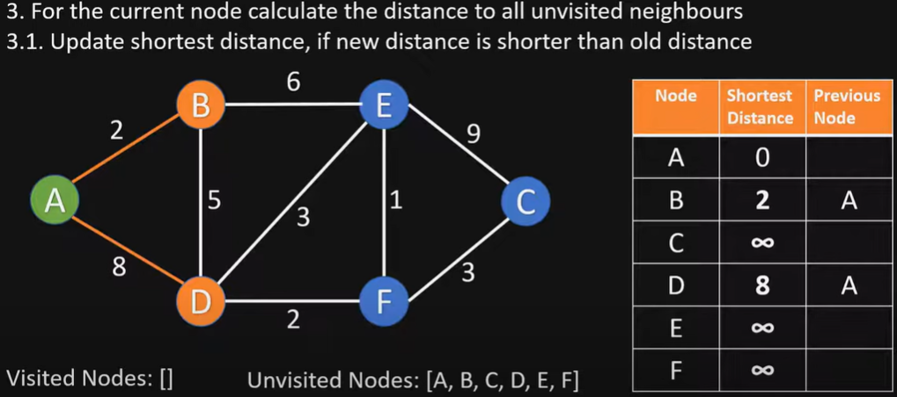
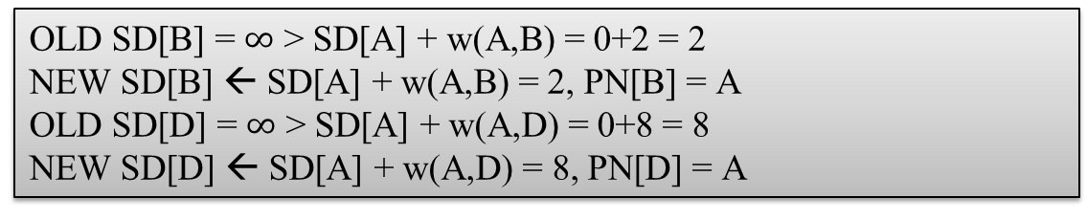
Visit node A
OLD SD[B] = $∞$ > SD[A] + w(A,B) = 0+2 = 2
NEW SD[B] ← SD[A] + w(A,B) = 2, PN[B] = A
OLD SD[D] = $∞$ > SD[A] + w(A,D) = 0+8 = 8
NEW SD[D] ← SD[A] + w(A,D) = 8, PN[D] = A

Slide 34
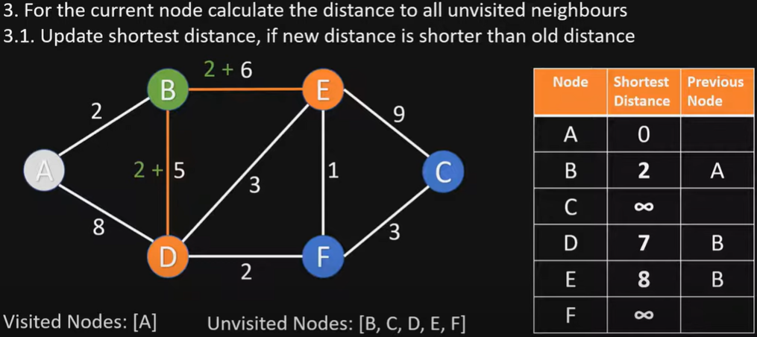
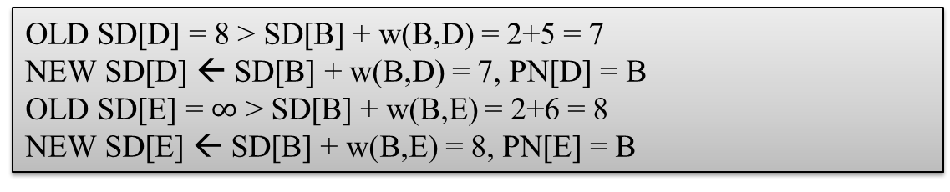
Visit node B
OLD SD[D] = 8 > SD[B] + w(B,D) = 2+5 = 7
NEW SD[D] ← SD[B] + w(B,D) = 7, PN[D] = B
OLD SD[E] = $∞$ > SD[B] + w(B,E) = 2+6 = 8
NEW SD[E] ← SD[B] + w(B,E) = 8, PN[E] = B

Slide 35
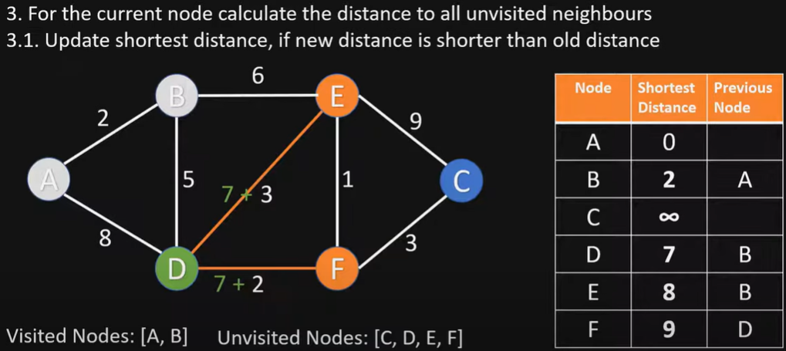
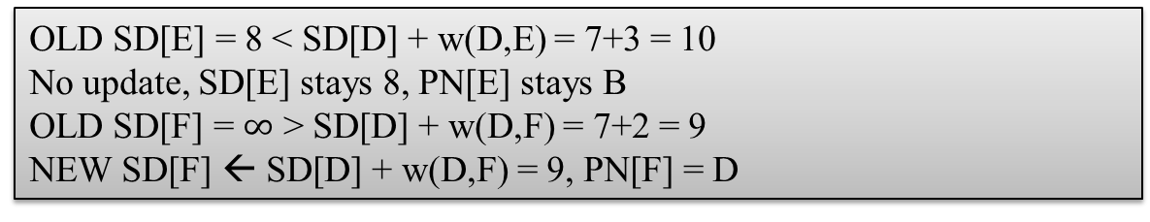
Visit node D
OLD SD[E] = 8 < SD[D] + w(D,E) = 7+3 = 10
No update, SD[E] stays 8, PN[E] stays B
OLD SD[F] = $∞$ > SD[D] + w(D,F) = 7+2 = 9
NEW SD[F] ← SD[D] + w(D,F) = 9, PN[F] = D

Slide 36
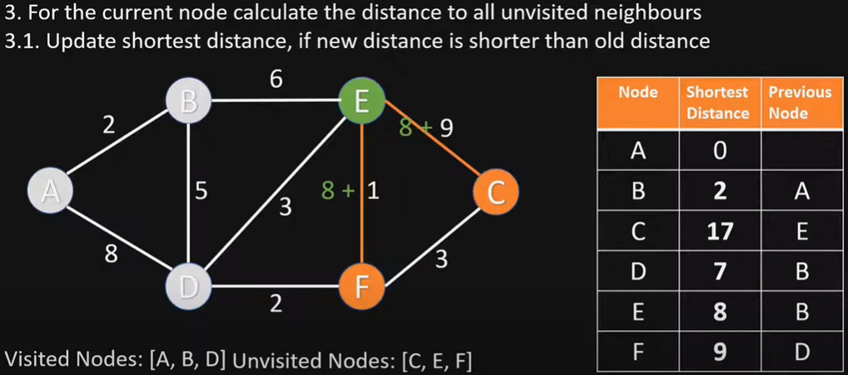
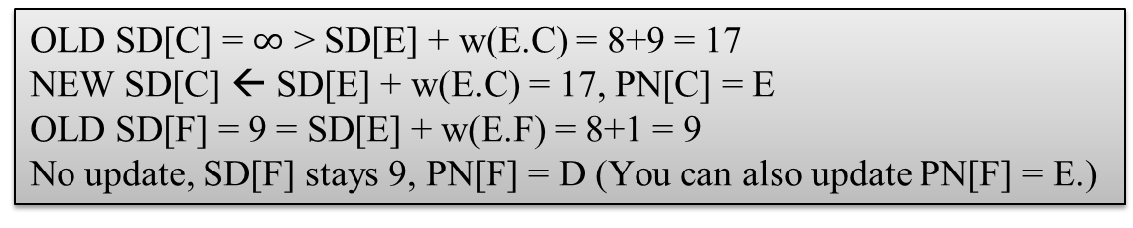
Visit node E
OLD SD[C] = $∞$ > SD[E] + w(E.C) = 8+9 = 17
NEW SD[C] ← SD[E] + w(E.C) = 17, PN[C] = E
OLD SD[F] = 9 = SD[E] + w(E.F) = 8+1 = 9
No update, SD[F] stays 9, PN[F] = D (You can also update PN[F] = E.)

Slide 37
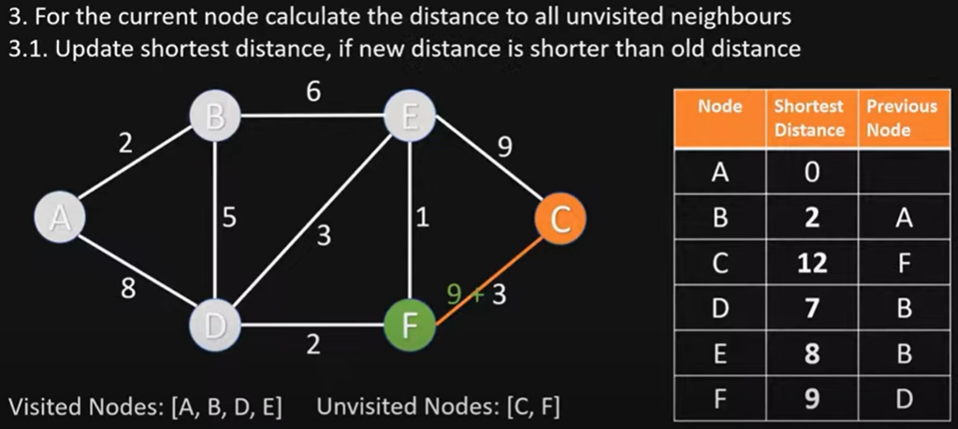
Visit node F
OLD SD[C] = 17 > SD[F] + w(F,C) = 9+3 = 12
NEW SD[C] ← SD[F] + w(F,C) = 12, PN[C] = F

Slide 38
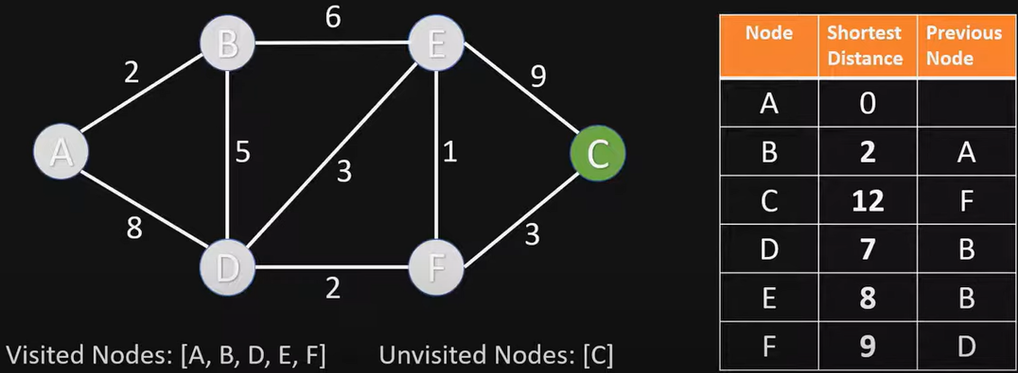
Visit node C
Nothing changes, since C has no unvisited neighbor nodes

Slide 39
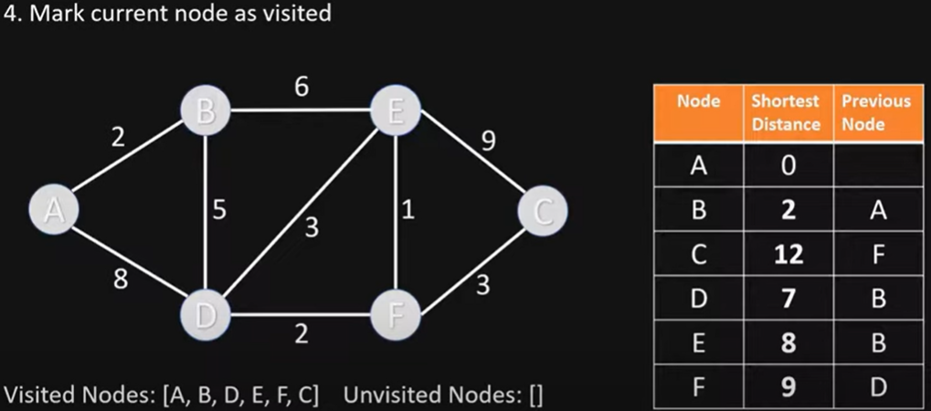
End of Algorithm
The table now contains the SD (shortest distance) to each node N from the source node A, and its PN (previous node) in the shortest path

Slide 40
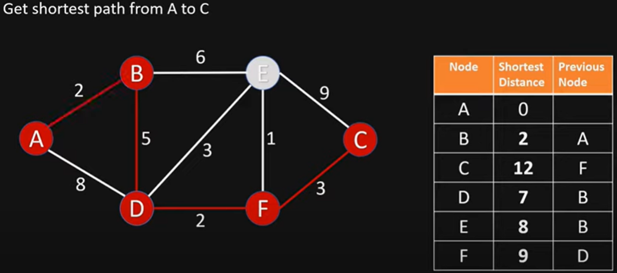
Getting the Shortest Path from A to C
C’s previous node is F; F’s previous node is D; D’s previous node is B; B’s previous node is A
Shortest Path from A to C is ABDFC

Slide 41
Example II Exam Question and Answer
Given this directed graph, run Dijkstra’s Algo to find shortest paths starting from source node A. Give the node visit order, and fill in this table of SN (Shortest Distance) and PN (Previous Node), crossing out old SD and PN as you find a shortcut path with smaller SD
Visit Order
A, B, D, E, F, C
Node | SD | PN
A | 0 | /
B | 2 | A
C | 17 12 | E F
D | 8 7 | A B
E | 8 | B
F | 9 | D
Notes:
At exam time, you will be given a graph with a start node (A), and required to fill in this table, crossing out old items as you find a shortcut path

Slide 42

choose node 5
relax all edges adjacent from 5
choose node 2
relax all edges adjacent from 2
choose node 3
relax all edges adjacent from 3
choose node 6
relax all edges adjacent from 6
Example III
1
v SD
Visit Order
0, 1, 7, 4, 5, 2, 3, 6
15
3
$$∞$$
$∞$ $∞$
$$∞$$
$$∞$$
$$∞$$
$$∞$$
$$∞$$
0
5
17
20
9
14
29
8
15
17
13
26
14
25
0
1
2
3
4
5
6
7
5
4
12
0
3
Node | SD | PN
0 | 0 | /
1 | 5 | 0
2 | 17 15 14 | 1 7 5
3 | 20 17 | 1 2
4 | 9 | 0
5 | 14 13 | 7 4
6 | 29 26 25 | 4 5 2
7 | 8 | 0
8
7
2
7
9
9
5
6
1
5
11
v PN
4
4
13
6
0
1
2
3
4
5
6
7
-
-
-
-
-
-
-
-
0
1
1
0
7
4
0
7
2
4
5
5
2
20
choose source node 0
relax all edges adjacent from 0
choose node 1
relax all edges adjacent from 1
choose node 7
relax all edges adjacent from 7
choose node 4
relax all edges adjacent from 4
42
Notes:
Consider nodes in increasing order of distance from s
(non-tree node with the lowest SD[ ] value).
Add node to tree and relax all edges pointing from that node.

Slide 43
BFS
Dijkstra’s Algorithm
Topological Sort
Bellman-Ford Algorithm
Johnson’s Algorithm
43

Slide 44
Topological Sort for Shortest Paths in DAG
Suppose that a graph is a Directed Acyclic Graph (DAG), i.e., it has no directed cycles. It is easier and faster to find shortest paths than in a general digraph.
Idea: Consider nodes in topological order. Relax all outgoing edges from that node
Time Complexity: O(V+E). After finding topological order, the algorithm process all nodes and for every node, it runs a loop for all adjacent nodes. Total adjacent nodes in a graph is O(E), so the double for loop has complexity O(V+E). Therefore, overall time complexity is O(V+E)
Topological Sort-based SPT for a DAG
For each node v: SD [v] = ∞.
For each node v: PN[v] = null.
SD [s] = 0.
Create a topological order of the DAG
For every node u in topological order:
- Relax all its outgoing edges
44
Notes:
Initialize dist[] = {$∞$,$∞$, ….} and dist[s] = 0 where s is the source node.
Create a topological order of all nodes.
For every node u in topological order
For every adjacent node v of u
if (dist[v] > dist[u] + weight(u, v)) //relax edge uv
dist[v] = dist[u] + weight(u, v)
Bellman–Ford algorithm
For each node v: SD [v] = ∞.
For each node v: PN[v] = null.
SD [s] = 0.
Repeat V-1 times:
- Relax each edge.

Slide 45
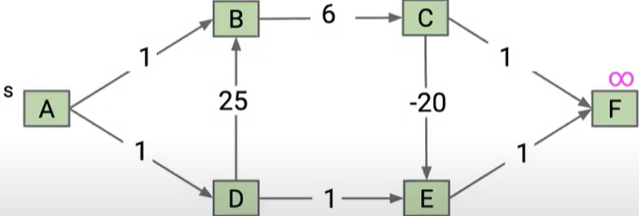
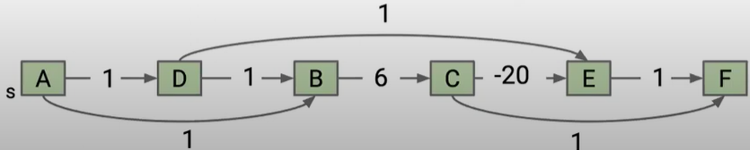
Topological Sort Example I
Consider this DAG, use Topological Sort to find Shortest Paths in DAG, considering the topological order ADBCEF (Different topological orders will result in different algorithm process, but final results will be the same)
1
45

Slide 46
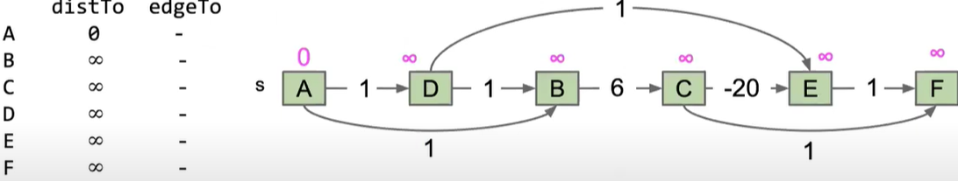
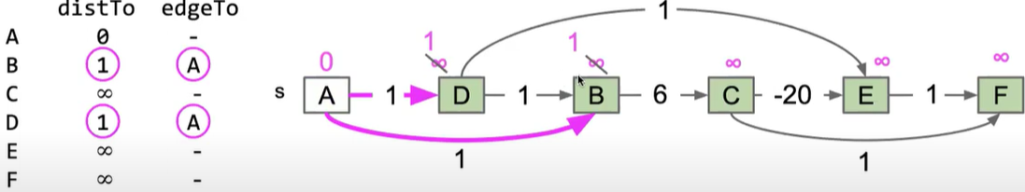
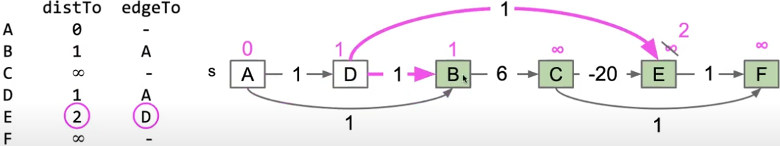
Here we use distTo to denote SD, edgeTo to denote PN
Initialize
Visit A
Here nodes B and D both have distTo equal to 1, so we may visit either one next. Suppose we choose to visit D next.
Visit D
46

Slide 47
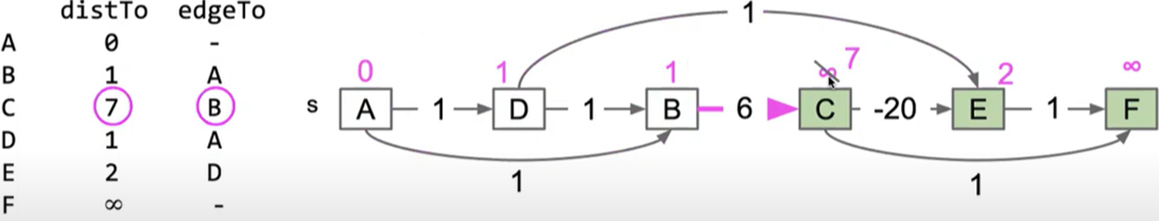
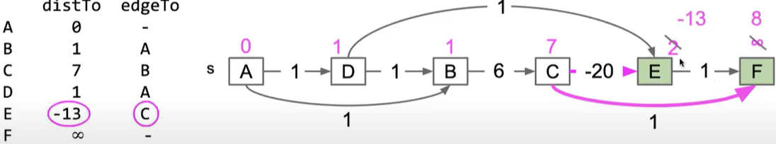
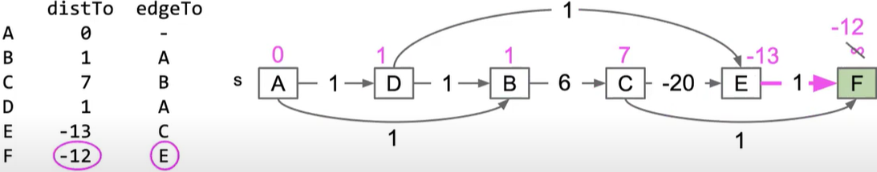
Visit B
Visit C
8
C
C
Visit E
47

Slide 48
Topological Sort Example I: Final Answer (for Exams
Visit Order
A, D, B, C, E, F
1
Node | SD | PN
A | 0 | /
B | 1 | A
C | 7 | B
D | 1 | A
E | 2 -13 | D C
F | 8 -12 | C E
48

Slide 49

Topological Sort Example II
Consider this DAG and a topological order 01475236
V SD
Visit Order
0, 1, 4, 7, 5, 2, 3, 6
0
1
2
3
4
5
6
7
$$∞$$
$∞$ $∞$
$$∞$$
$$∞$$
$$∞$$
$$∞$$
$$∞$$
0
5
17
20
9
13
29
8
15
17
26
14
25
0 1 4 7 5 2 3 6
Node | SD | PN
0 | 0 | /
1 | 5 | 0
2 | 17 15 14 | 1 7 5
3 | 20 17 | 1 2
4 | 9 | 0
5 | 13 | 4
6 | 29 26 25 | 4 5 2
7 | 8 | 0
1
15
3
5
4
12
0
3
v PN
8
7
2
0
1
2
3
4
5
6
7
-
-
-
-
-
-
-
-
0
1
1
0
4
4
0
7
2
5
5
2
7
9
9
5
6
1
5
11
4
4
13
20
6
49

Slide 50
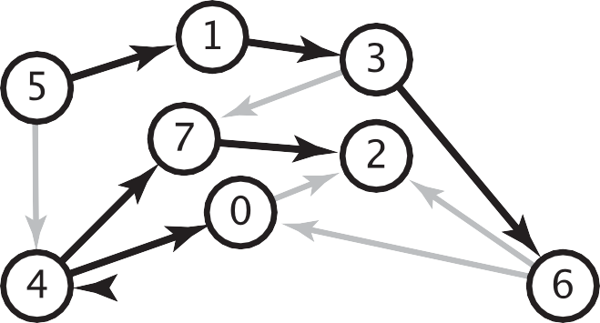
Longest Paths in a DAG
Formulate as a shortest paths problem in edge-weighted DAGs.
Negate all weights
Find shortest paths
Negate all the weights and path lengths
For general graphs, the longest paths problem is an unsolved problem (exponential time at best)
longest paths input
shortest paths input
5->4 | 0.35 | 5->4 | -0.35
4->7 | 0.37 | 4->7 | -0.37
5->7 | 0.28 | 5->7 | -0.28
5->1 | 0.32 | 5->1 | -0.32
4->0 | 0.38 | 4->0 | -0.38
0->2 | 0.26 | 0->2 | -0.26
3->7 | 0.39 | 3->7 | -0.39
1->3 | 0.29 | 1->3 | -0.29
7->2 | 0.34 | 7->2 | -0.34
6->2 | 0.40 | 6->2 | -0.40
3->6 | 0.52 | 3->6 | -0.52
6->0 | 0.58 | 6->0 | -0.58
6->4 | 0.93 | 6->4 | -0.93
s
50

Slide 51
BFS
Dijkstra’s Algorithm
Topological Sort
Bellman-Ford Algorithm
Johnson’s Algorithm
51

Slide 52
Bellman-Ford Algorithm
A shortest path algorithm that works with negative edge weights
There can be at most V - 1 edges in our shortest path
If there are V or more edges in a path that means there’s a cycle/repeated node
Run V - 1 iterations of shortest path analysis through the graph
Repeatedly revisit and update SD and PN
Look at each node’s outgoing edges in each iteration
It is slower than Dijkstra’s because it will revisit previously assessed nodes
Can terminate early when all SD values have converged
The order of edge relaxations affects algorithm efficiency but not correctness
Time complexity:
Worst Case: O(VE)
Average Case: O(VE)
If the graph is dense or complete, the value of E becomes O(V²). So overall time complexity becomes O(V³)
Bellman-Ford, by Michael Sambol
https://www.youtube.com/watch?v=9PHkk0UavIM
https://www.youtube.com/watch?v=obWXjtg0L64
Bellman–Ford algorithm
For each node v: SD [v] = ∞.
For each node v: PN[v] = null.
SD [s] = 0.
Repeat V-1 times:
- Relax each edge.
Notes:
https://www.youtube.com/watch?v=9PHkk0UavIM
Relax all edges V-1 times.

Slide 53
Bellman-Ford Example
0
10
∞
1
∞
start
S
A
B
8
2
∞
-4
-2
E
node | SD | PN
S | 0
A | ∞
B | ∞
C | ∞
D | ∞
E | ∞
1
∞
∞
-1
C
D
Notes:
We visit nodes in this order in each iteration: S, A, B, C, D, E

Slide 54
Bellman-Ford Example
0
10
10
1
10
start
S
A
B
8
Iteration 1 - for each node’s outgoing edge, does that give us a shorter way to get to a new node?
2
8
-4
-2
E
node | SD | PN
S | 0 | -
A | 10 | S
B | 10 | C
C | 12 | A
D | 9 | E
E | 8 | A
1
12
9
-1
C
D

Slide 55
Bellman-Ford Example
0
10
10
1
10
start
S
A
B
8
Iteration 2 - re-examining outgoing edges, can we improve the distance to any given node?
2
8
-4
-2
E
node | SD | PN
S | 0 | -
A | 10 | S
B | 10 | C
C | 12 | A
D | 9 | E
E | 8 | A
1
12
9
-1
C
D
5
D
8
D
Notes:
* Because a distance to D is known by the time we process D we can include D’s outgoing edges for consideration

Slide 56
Bellman-Ford Example
0
10
10
1
10
start
S
A
B
8
Iteration 3 - repeat!
2
8
-4
-2
E
node | SD | PN
S | 0 | -
A | 5 | D
B | 10 | C
C | 8 | A
D | 9 | E
E | 8 | A
1
12
9
-1
C
* With a shortened distance to A from iteration 2 we can improve the distance to C
D
5
7
* With a shortened distance to C in this iteration we can improve distance to B

Slide 57
Bellman-Ford Example
0
10
10
1
10
start
S
A
B
8
Iteration 4 - repeat!
2
8
-4
-2
E
node | SD | PN
S | 0 | -
A | 5 | D
B | 5 | C
C | 7 | A
D | 9 | E
E | 8 | A
No changes!
this means we can stop early
1
12
9
-1
C
D
I will not ask you to run Bellman-Ford algo in the final exam

Slide 58

Bellman-Ford Example II
v SD[]
0
1
2
3
4
5
6
7
$$∞$$
$∞$ $∞$
$$∞$$
$$∞$$
$$∞$$
$$∞$$
$$∞$$
0
5
17
20
9
13
28
8
14
17
26
25
1
15
3
5
4
12
0
3
8
7
2
7
9
v PN[]
9
5
6
1
0
1
2
3
4
5
6
7
-
-
-
-
-
-
-
-
0
1
1
0
4
2
0
5
2
5
2
5
11
4
4
13
Reverse order of edge relaxations will result in slower convergence
20
6
Iter 1
Iter 2
Iter 3
(converged, no further changes, so stop here)
I will not ask you to run Bellman-Ford algo in the final exam
Notes:
Repeat V − 1 times: relax all E edges.

Slide 59
A Toy Example with Negative Edge Weights
Let’s run Dijkstra’s algorithm, Topological Sort, and Bellman Ford Algorithm on this DAG with a negative edge weight
B
10
-20
A
D
1
E
1
1
C

Slide 60
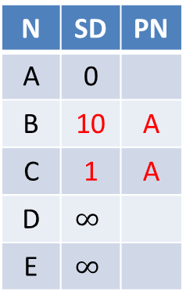
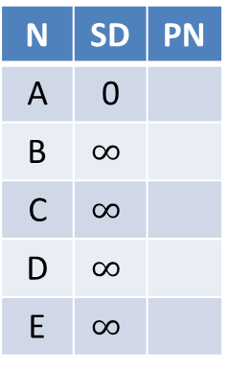
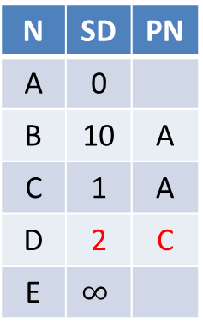
Dijkstra’s algorithm does not work for a graph w/ negative edge weights
N | SD | PN
A | 0
B | $$∞$$
C | $$∞$$
D | $$∞$$
E | $$∞$$
N | SD | PN
A | 0
B | 10 | A
C | 1 | A
D | $$∞$$
E | $$∞$$
N | SD | PN
A | 0
B | 10 | A
C | 1 | A
D | 2 | C
E | $$∞$$
N | SD | PN
A | 0
B | 10 | A
C | 1 | A
D | 2 | C
E | 3 | D
Visit A
Visit C
Visit D
Visit B
N | SD | PN
A | 0
B | 10 | A
C | 1 | A
D | -10 | B
E | 3 | D
N | SD | PN
A | 0
B | 10 | A
C | 1 | A
D | -10 | B
E | 3 | D
Visit E
B
Visit E
10
-20
A
D
1
E
E’s SD of 3 is Incorrect
1
1
C

Slide 61
Dijkstra’s algorithm does not work for a graph w/ negative edge weights
Dijkstra’s Algorithm is greedy: each node is visited once, and any node that has been visited should have its shortest distance from the source.
After visiting A, C, D, we have computed D’s SD is 2, but after visiting B, D’s SD is updated to -10, which violates the greedy optimal assumption.
Even if we update D’s SD to be -10, its downstream node E’s SD will not be updated.
We cannot visit B before D, since we must visit the closest unknown node (with smallest SD), which is D. (Unlike topological sort, which visits B before D and gets the correct result,)

Slide 62
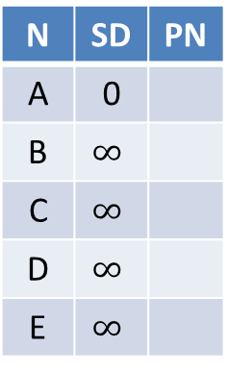
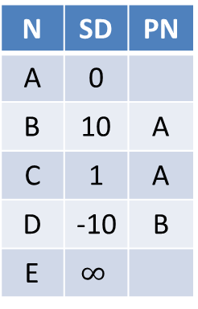
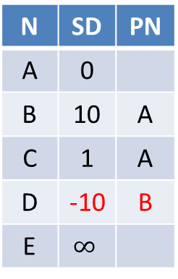
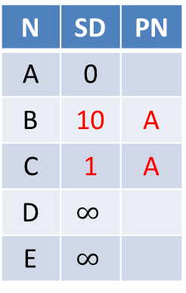
Topological sort works for a DAG w/ negative edge weights
N | SD | PN
A | 0
B | $$∞$$
C | $$∞$$
D | $$∞$$
E | $$∞$$
N | SD | PN
A | 0
B | 10 | A
C | 1 | A
D | $$∞$$
E | $$∞$$
N | SD | PN
A | 0
B | 10 | A
C | 1 | A
D | -10 | B
E | $$∞$$
N | SD | PN
A | 0
B | 10 | A
C | 1 | A
D | -10 | B
E | $$∞$$
Visit A
Visit B
Visit C
Visit D
N | SD | PN
A | 0
B | 10 | A
C | 1 | A
D | -10 | B
E | -9 | D
N | SD | PN
A | 0
B | 10 | A
C | 1 | A
D | -10 | B
E | -9 | D
B
Visit E
10
-20
A
D
1
E
1
1
C
Consider topological order ABCDE
Notes:
Topological sort algorithm for DAGs works even with negative weights

Slide 63
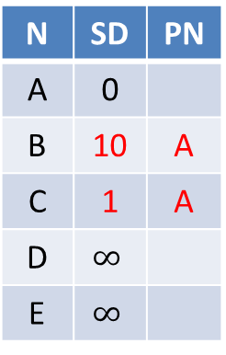

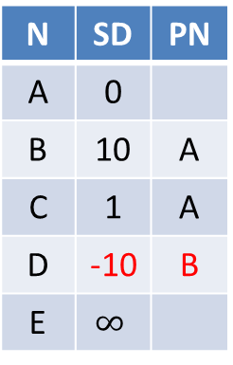
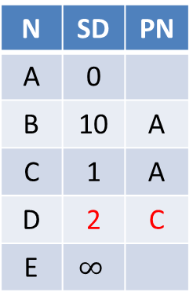
Topological sort works for a DAG w/ negative edge weights
N | SD | PN
A | 0
B | $$∞$$
C | $$∞$$
D | $$∞$$
E | $$∞$$
N | SD | PN
A | 0
B | 10 | A
C | 1 | A
D | $$∞$$
E | $$∞$$
N | SD | PN
A | 0
B | 10 | A
C | 1 | A
D | 2 | C
E | $$∞$$
N | SD | PN
A | 0
B | 10 | A
C | 1 | A
D | -10 | B
E | $$∞$$
Visit A
Visit C
Visit B
Visit D
N | SD | PN
A | 0
B | 10 | A
C | 1 | A
D | -10 | B
E | -9 | D
N | SD | PN
A | 0
B | 10 | A
C | 1 | A
D | -10 | B
E | -9 | D
B
Visit E
10
-20
A
D
1
E
1
1
C
Consider topological order ACBDE

Slide 64
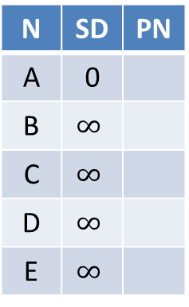
Bellman Ford works for a graph with negative edge weights
N | SD | PN
A | 0
B | $$∞$$
C | $$∞$$
D | $$∞$$
E | $$∞$$
N | SD | PN
A | 0
B | 10 | A
C | 1 | A
D | -10 | B
E | -9 | D
N | SD | PN
A | 0
B | 10 | A
C | 1 | A
D | -10 | B
E | -9 | D
Iter 1
Iter 2
No change
converged
B
Suppose we visit nodes in this order at each iteration: A, B, C, D, E. We run for 2 iterations (less than V-1=3 iterations), and converge to the correct SPT
10
-20
A
D
1
E
1
1
C
Notes:
There are no negative weight cycles.
obtained shortest paths from node A to all other nodes.
The shortest path from A to D is ABD with cost of -10

Slide 65
Dijkstra's Algorithm vs. Bellman-Ford Algorithm
Dijkstra's Algorithm:
Uses a priority queue to select the next node to process.
Greedily selects the node with the smallest tentative distance to source node.
Works only on graphs with non-negative edge weights.
Bellman-Ford Algorithm:
Iteratively relaxes all edges V-1 times.
Can handle graphs with negative edge weights, and can detect negative cycles.
Relax all the edges one more time, i.e. the V-th time. Negative cycle exists if any edge can be further relaxed
It can find any negative cycle that is reachable from source node s (but not negative cycles that are unreachable from s).
If there is a negative cycle that is reachable from source node s, then any paths that go through the cycle has distance −∞, since the cost can be reduced by traversing the cycle infinite number of times.
Dijkstra's algorithm is faster and more efficient for graphs with non-negative weights; Bellman-Ford Algorithm is more versatile as it can handle negative weights and detect negative cycles, albeit at the cost of lower efficiency
Notes:
Does not use a priority queue.

Slide 66
BFS
Dijkstra’s Algorithm
Topological Sort
Bellman-Ford Algorithm
Johnson’s Algorithm
66

Slide 67
Johnson’s Algorithm for all-pairs shortest paths
Idea: run Dijkstra’s Single Source shortest path algorithm with every node as the source.
Dijkstra’s algorithm doesn’t work for negative weight edge. The idea of Johnson’s algorithm is to reweight all edges and make them all positive, then run Dijkstra’s algorithm with every node as the source.
We can run Bellman-Ford algorithm with every node as the source without reweighting, since Bellman-Ford algorithm can handle negative edge weights, but the time complexity is much higher than running Dijkstra’s algorithm.
How to transform a given graph into a graph with non-negative weight edges without changing the shortest paths?
67

Slide 68
Example I: Increase weight of every edge by a constant?
True or False: In a weighted graph, assume that the shortest path from source s to destination t is correctly calculated using a shortest path algorithm. If we increase weight of every edge by a constant, the shortest path always remains same.
False. See the following counterexample. There are 4 edges sa, ab, bt and st with weights 1, 1, 1 and 4 respectively. The shortest path from s to t is sabt with cost 3. If we increase weight of every edge by 1, the shortest path changes to st with cost 5.
Similarly for negative weight edges. There are 4 edges sa, ab, bt and st with weights -1, -1, -1 and -2 respectively. The shortest path from s to t is sabt with cost -3. If we increase weight of every edge by 1, the shortest path changes to st with cost -1.
s
1
a
1
b
1
t
2
2
2
s
a
b
t
4
5
s
- 1
a
- 1
b
- 1
t
s
0
a
0
b
0
t
-2
68
-1
Notes:
1 1
s-----a-----b-----t
\ /
\ /
\ __4 __/

Slide 69
Double the original weights?
True or False: Is the following statement valid about shortest paths? Given a graph, suppose we have calculated shortest path from a source to all other vertices. If we modify the graph such that weights of all edges becomes double of the original weight, then the shortest path remains same, and only the total weight of path changes.
True. The shortest path remains same. It is like if we change unit of distance from meter to kilo meter, the shortest paths do not change. But this does not make weights positive.
69

Slide 70
Johnson’s algorithm for All-pairs Shortest Paths
Let the given graph be G. Add a dummy source node d, and add edges with weight 0 from d to all vertices of G. Let the modified graph be G’.
Run Bellman-Ford on G’ with d as the source. Let the shortest distances calculated by Bellman-Ford be h[0], h[1], .. h[V-1]. If we find a negative weight cycle, then return. (We run Bellman-Ford algorithm since it can handle negative edge weights.)
Reweight the edges of the original graph. For each edge (u, v), assign the new weight as w'(u, v) = w(u, v) + h[u] – h[v], which is greater than or equal to 0.
Remove the added dummy node d, and run Dijkstra’s algorithm with every node as the source to obtain all-pairs shortest paths. Subtract h[s] – h[t] from length of each shortest path from s to t to obtain the lengths of shortest paths in the original graph.
Time complexity: Johnson’s algorithm uses both Dijkstra and Bellman-Ford as subroutines. The main steps in the algorithm are Bellman-Ford Algorithm called once and Dijkstra called V times. Time complexity of Bellman Ford is O(VE) and time complexity of Dijkstra is O((V + E) log V). So overall time complexity is O((V² + VE) log V).
70
Notes:
Note that the negative weight cycle cannot be created by new node s as there is no edge to s. All edges are from s.
After adding a dummy source node d and edge reweighting, all edge weights are greater than or equal to 0, so we can run Dijkstra’s shortest path algorithm with every node as the source.

Slide 71
Johnson’s Algorithm: Proof
The following property is always true since h[] values are the shortest distances from the dummy source code d:
h[v] <= h[u] + w(u, v)
The property states that the shortest distance from u to v must be smaller than or equal to the shortest distance from s to u plus edge weight w(u, v).
If h[v] > h[u] + w(u, v), then Bellman-Ford with starting node d will set h[v] = h[u] + w(u, v), after visiting u and performing edge relaxation
Because of this inequality, the new weights w’(u, v) = w(u, v) + h[u] – h[v] must be greater than or equal to 0.
After reweighting, all weights become non-negative, and lengths of all paths between any two vertices s and t is increased by the same amount, hence the shortest paths remain the same as the original graph before reweighting.
Consider any path between two vertices s and t, the weight of every path is increased by h[s] – h[t], since the added h[] values for all intermediate vertices on the path from s to t cancel each other out
Consider two path between s and t: s->x->y->t, and s->x’->y’->t. Distance of the 1st path s->x->y->t is increased by h(s)-h(x)+h(x)-h(y)+h(y)-h(t)=h(s)-h(t), and distance of the 2nd path s->x’->y’->t is increased by h(s)-h(x’)+h(x')-h(y’)+h(y’)-h(t)=h(s)-h(t)
d
h(u)
h(v)
u
w(u,v)
v
71
Notes:
We add a source s and add edges from s to all vertices of the original graph. In the following diagram s is 4.

Slide 72
Johnson’s Algorithm Example I
Add a dummy source node d and add edges with weight 0 from s to all vertices of the original graph.
Run Bellman-Ford algorithm to calculate the shortest distances from d to all other vertices. The shortest distances from d to s, a, b and t are
h[s]=0 (path d→0), h[a]=-1 (path d→s→a), h[b]=-2 (path d→s→a→b), h[t]=-3 (path d→s→a→b→t)
Remove node d and reweight each edge uv as: w'(u, v) = w(u, v) + h[u] – h[v].
w’(s, a) = w(s, a) + h[s] – h[a] = -1 + 0 - (-1) = 0
w’(a, b) = w(a, b) + h[a] – h[b] = -1 + -1 - (-2) = 0
w’(b, t) = w(b, t) + h[b] – h[t] = -1 + -2 - (-3) = 0
w’(s, t) = w(s, t) + h[s] – h[t] = -2 + 0 - (-3) = 1
N | h(N)
s | 0
a | -1
b | -2
t | -3
Shortest paths starting from dummy node
d
0
0
0
0
s
- 1
a
- 1
b
- 1
t
s
- 1
a
- 1
b
- 1
t
s
0
a
0
b
0
t
h[s]=0
h[a]=-1
h[b]=-2
h[t]=-3
-2
-2
1
Original graph
Original graph
w/ dummy node
Reweighted graph
72

Slide 73
Johnson’s Algorithm Example I Con’t
Since all weights are now greater than or equal to 0, run Dijkstra’s shortest path algorithm on the reweighted graph with every node as the source. Let’s start from source node s for example, and obtain the shortest paths table for the reweighted graph
We then subtract h[s] – h[t] from length of each shortest path from s to t to obtain the shortest paths table for the original graph (PN stays the same)
SD(a) = SD’(a) - (h[s] - h[a]) = 0 - (0 - (-1)) = -1
SD(b) = SD’(b) - (h[s] - h[b]) = 0 - (0 - (-2)) = -2
SD(t) = SD’(t) - (h[s] - h[t]) = 0 - (0 - (-3)) = -3
0
0
0
s
- 1
a
- 1
b
- 1
t
s
a
b
t
h[s]=0
h[a]=-1
h[b]=-2
h[t]=-3
-2
1
Reweighted graph
Original graph
N | h(N)
s | 0
a | -1
b | -2
t | -3
N | SD’ | PN
s | 0 | /
a | 0 | s
b | 0 | a
t | 0 | b
N | SD | PN
s | 0 | /
a | -1 | s
b | -2 | a
t | -3 | b
Shortest paths starting from dummy node
Shortest paths from s in reweighted graph
Shortest paths from s in original graph
73
Notes:
to find shortest paths starting from source node 1w’(s, a) = w(s, a) + h[s] – h[a] = -1 + 0 - (-1) = 0
w’(a, b) = w(a, b) + h[a] – h[b] = -1 + -1 - (-2) = 0
w’(b, t) = w(b, t) + h[b] – h[t] = -1 + -2 - (-3) = 0
w’(s, t) = w(s, t) + h[s] – h[t] = -2 + 0 - (-3) = 1
We then subtract h[u] – h[v] from length of each shortest path from u to v to obtain the lengths of shortest paths in the original graph.
e.g., shortest path from s to t is sabt, same as the original graph before reweighting. Its length in the original graph is 0 – (h[s] – h[t]) = 0 – (0 – (-3)) = -3

Slide 74
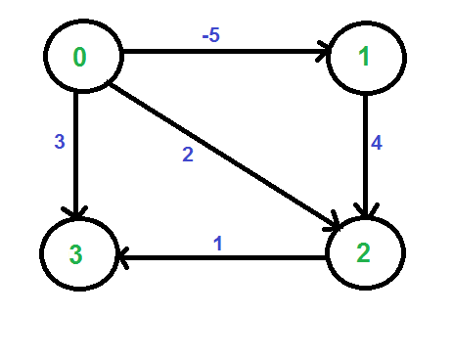
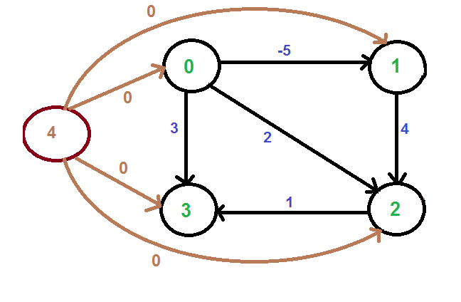
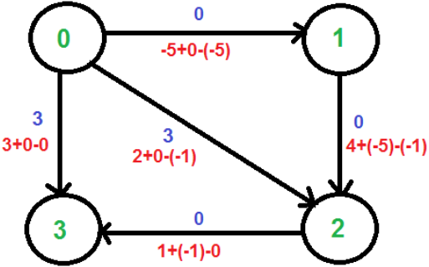
Johnson’s Algorithm Example II
Add a dummy source node d and add edges with weight 0 from s to all vertices of the original graph.
Run Bellman-Ford algorithm to calculate the shortest distances from d to all other vertices. The shortest distances from d to 0, 1, 2 and 3 are
h[0]=0 (path d→0), h[1]=-5 (path d→0→1), h[2]=-1 (path d→0→1→2), h[3]=0 (path d→3)
Remove node d and reweight each edge uv as: w'(u, v) = w(u, v) + h[u] – h[v].
w’(0,1)=-5+0-(-5)=0, w’(1,2)=4+(-5)-(-1)=0, w’(2,3)=1+(-1)-0=0, w’(0,3)=3+0-0=3, w’(0,2)=2+0-(-1)=3
Since all weights are now greater than or equal to 0, run Dijkstra’s algorithm on the reweighted graph with every node as the source
N | h(N)
0 | 0
1 | -5
2 | -1
3 | 0
Shortest paths starting from dummy node
h[0]=0
h[1]=-5
d
h[3]=0
h[2]=-1
Original graph
Original graph
w/ dummy node
Reweighted graph
74

Slide 75

Johnson’s Algorithm Example II Con’t
Let’s run Dijkstra’s algorithm starting from source node 0, and obtain the shortest paths table for the reweighted graph
We then subtract h[s] – h[t] from length of each shortest path from s to t to obtain the shortest paths table for the original graph (PN stays the same)
SD(1)=SD’(1)-(h[0]-h[1])=0-(0-(-5))=-5
SD(2)=SD’(2)-(h[0]-h[2])=0-(0-(-1))=-1
SD(3)=SD’(3)-(h[0]-h[3])=0-(0-0)=0)
h[0]=0
h[1]=-5
h[3]=0
h[2]=-1
Reweighted graph
Original graph
N | h(N)
0 | 0
1 | -5
2 | -1
3 | 0
N | SD’ | PN
0 | 0 | /
1 | 0 | 0
2 | 0 | 1
3 | 0 | 2
N | SD | PN
0 | 0 | /
1 | -5 | 0
2 | -1 | 1
3 | 0 | 2
Shortest paths starting from dummy node
Shortest paths from 0 in reweighted graph
Shortest paths from 0 in original graph
75
Notes:
to find shortest paths starting from source node 1

Slide 76
Single Source Shortest-paths Algorithms Summary
Algorithm | Applicability | Worst-Case Complexity
Breadth First Search (BFS) | Unweighted, undirected or directed graph | Adjacency List: O(V + E) Adjacency Matrix: O(V²)
Dijkstra’s algorithm | Undirected or directed graph; no negative weights/cycles | O((V+E) log V) (binary min-heap)
Topological Sort | Directed Acyclic Graph (DAG) (no cycles, negative weights OK) | O(V+E)
Bellman-Ford algorithm | Directed graph with negative weights; undirected graph with no negative weights (since a negative weight edge forms a negative cycle by itself) | O(VE)
Johnson’s algorithm | Same as Bellman-Ford | O((V² + VE) log V)
76
Notes:
Adjacency List: O(V + E)
Each node is processed exactly once: O(V)
Each edge is examined exactly once: O(E)
Total complexity: O(V + E)
Efficient for sparse graphs (where E is much less than V²)
Using Adjacency Matrix: O(V²)
worst case O(VlogV+E)
Remark 1. Directed cycles make the problem harder.
Remark 2. Negative weights make the problem harder.
Remark 3. Negative cycles makes the problem ill-defined.
E+V
E+V
Dijkstra (binary heap)
E log V
E log V
Bellman-Ford
EV
EV

Slide 77
References
Dijkstras Shortest Path Algorithm Explained | With Example | Graph Theory
https://www.youtube.com/watch?v=bZkzH5x0SKU
Dijkstra's algorithm in 3 minutes
https://www.youtube.com/watch?v=_lHSawdgXpI
Topological sort
https://www.geeksforgeeks.org/topological-sorting-indegree-based-solution/
Bellman-Ford, Michael Sambol
https://www.youtube.com/watch?v=9PHkk0UavIM
https://www.youtube.com/watch?v=obWXjtg0L64
Bellman Ford Shortest Path Algorithm, ByteQuest
https://www.youtube.com/watch?v=B5PmlJACZ9Y
Shortest Path Algorithms Explained (Dijkstra's & Bellman-Ford), b001
https://www.youtube.com/watch?v=TtQi1LVVOUI
Johnson’s algorithm for All-pairs shortest paths
https://www.geeksforgeeks.org/johnsons-algorithm/
Johnson's Algorithm Explained, Basics Strong
https://www.youtube.com/watch?v=MV7EAD9zL64
@14:36 The 0->4 edge weight was incorrectly changed from 1 to 0
(Complexity analysis óf Dijkstra's algorithm is different since it is based on a different min-heap algorithm)
Notes:
Geeksforgeeks topological sort
https://www.geeksforgeeks.org/topological-sorting-indegree-based-solution/
Bellman Ford Algorithm Explained
Basics Strong
Bellman-Ford Shortest Path Algorithm Visually Explained
ByteVigor
Johnson's Algorithm| All pair shortest path algorithm| Harshit jain[NITA]
Harshit jain https://www.youtube.com/watch?v=wCjEP8TYi-E

Slide 78
Full-Length Lectures
[CSE 373 WI24] Lecture 15: Shortest Path
https://www.youtube.com/watch?v=L8nhMwhUn4U&list=PLEcoVsAaONjd5n69K84sSmAuvTrTQT_Nl&index=14
Notes:
Geeksforgeeks topological sort
https://www.geeksforgeeks.org/topological-sorting-indegree-based-solution/
Bellman Ford Algorithm Explained
Basics Strong
Bellman-Ford Shortest Path Algorithm Visually Explained
ByteVigor
Johnson's Algorithm| All pair shortest path algorithm| Harshit jain[NITA]
Harshit jain https://www.youtube.com/watch?v=wCjEP8TYi-E

